Slide 1

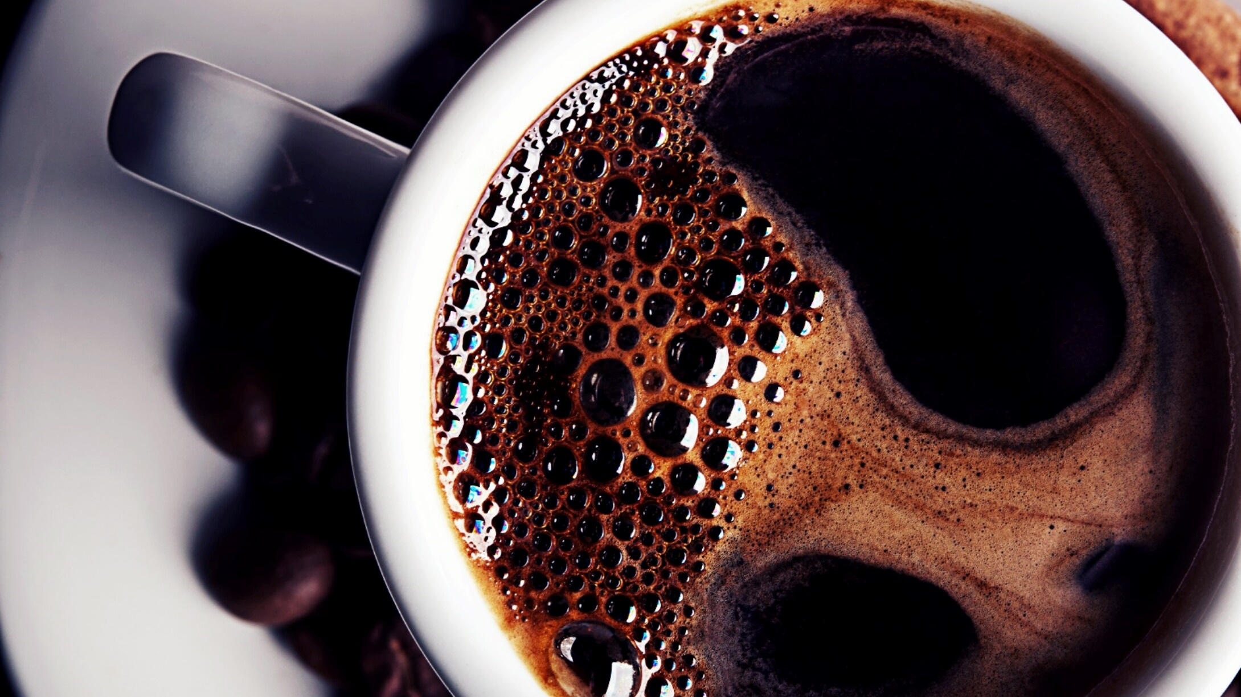
PIE-LICIOUS
Bakery

Slide 2
OUTLINE
About the website
Objective
Requirements
Languages learned
Snapshots from the website

Slide 3
About the website:
PIE-LICIOUS is a bakery management system website that helps the cashier to generate the bill of the items purchased by the customer and also generates the warning for restocking the items.

Slide 4
Objective:
In bakery the traditional hand-written method for writing bill keep track of the record is inefficient and leads to loss of the organization. The problem is capturing of data and keeping accurate records of the stock details daily purchase and sales. The purpose of our website is to solve all the above problem

Slide 5
Requirements:
Software Specification:
Technology implemented- Full-stack Web Development
IDE- Visual Studio
Browser- Google Chrome

Slide 6
Hardware requirements:
Operating System- Windows10
RAM- 4GB
Hard Disk- 256GB

Slide 7
Languages learned:
Form Design- HTML, CSS
Database design- Maria DB
Coding- PHP
Testing-(XAMPP Server)

Slide 8
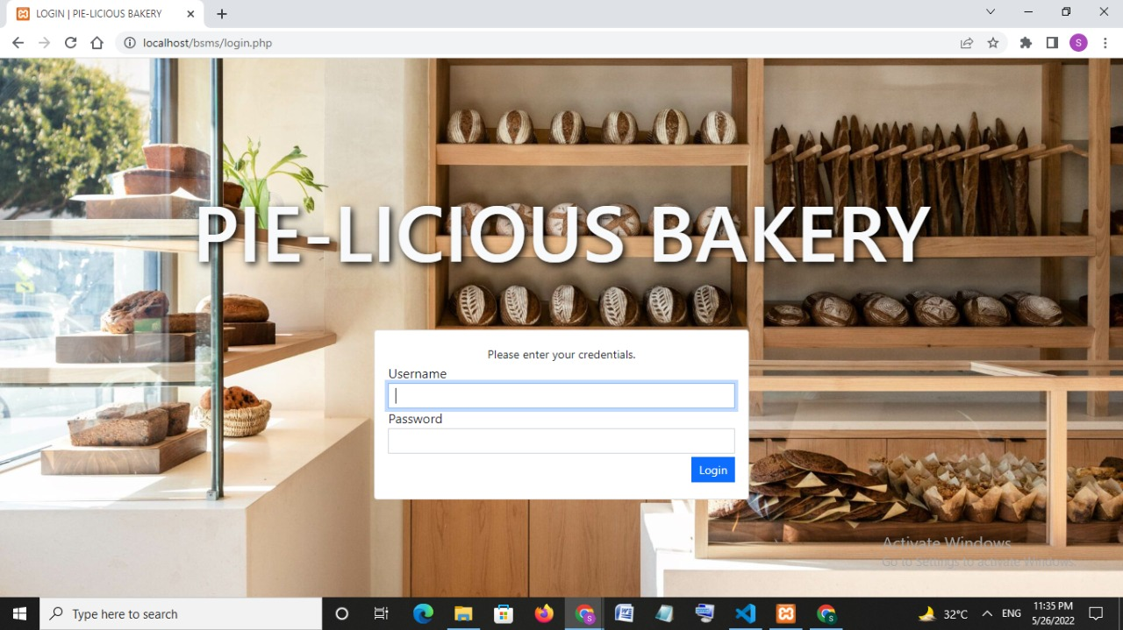
Login page:

Slide 9
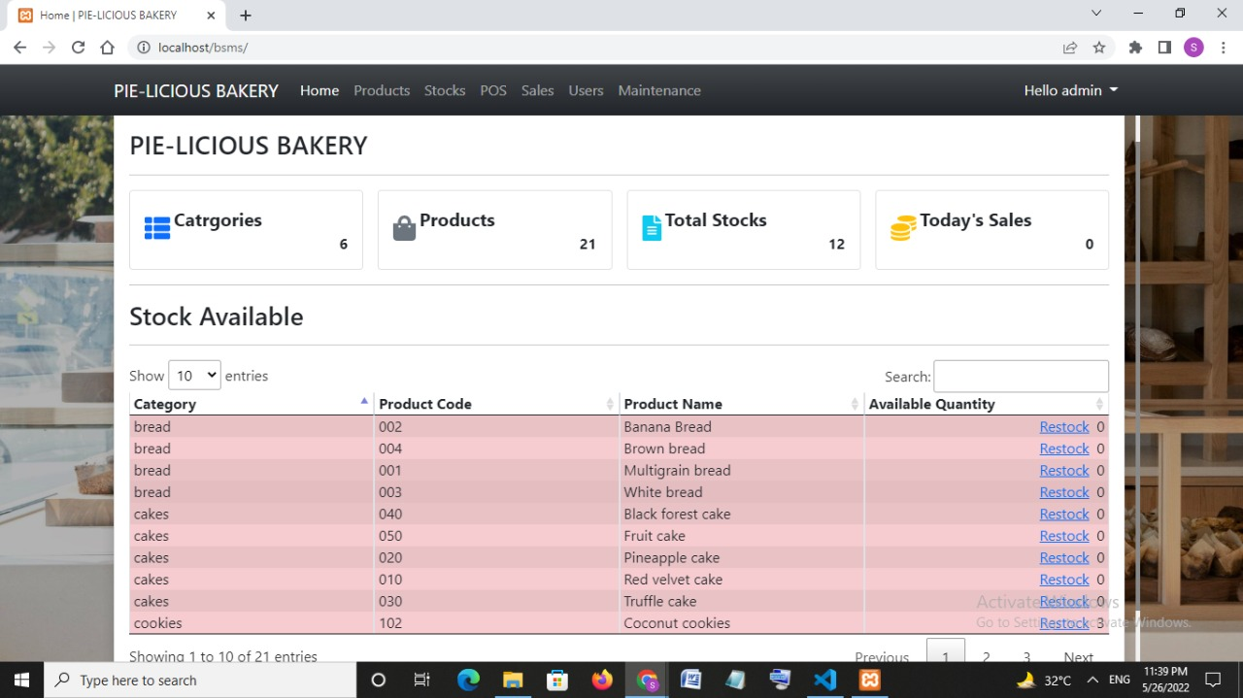
Home page:

Slide 10
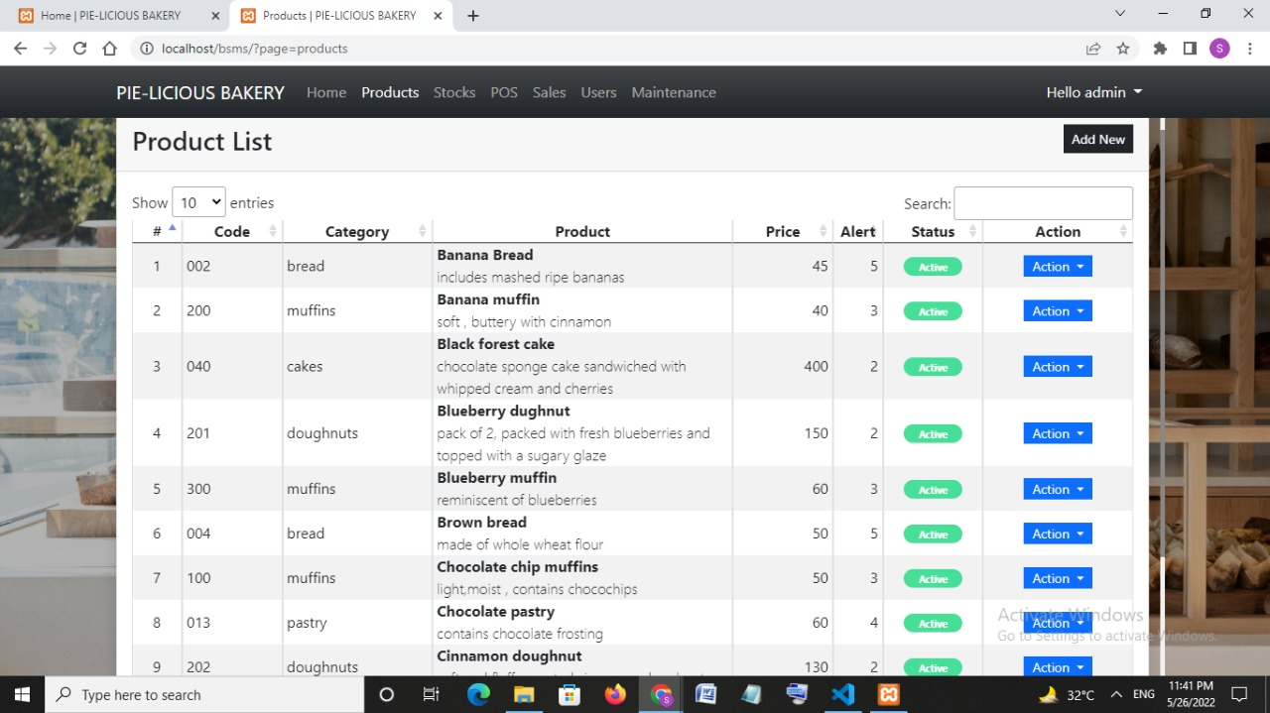
Product list:

Slide 11
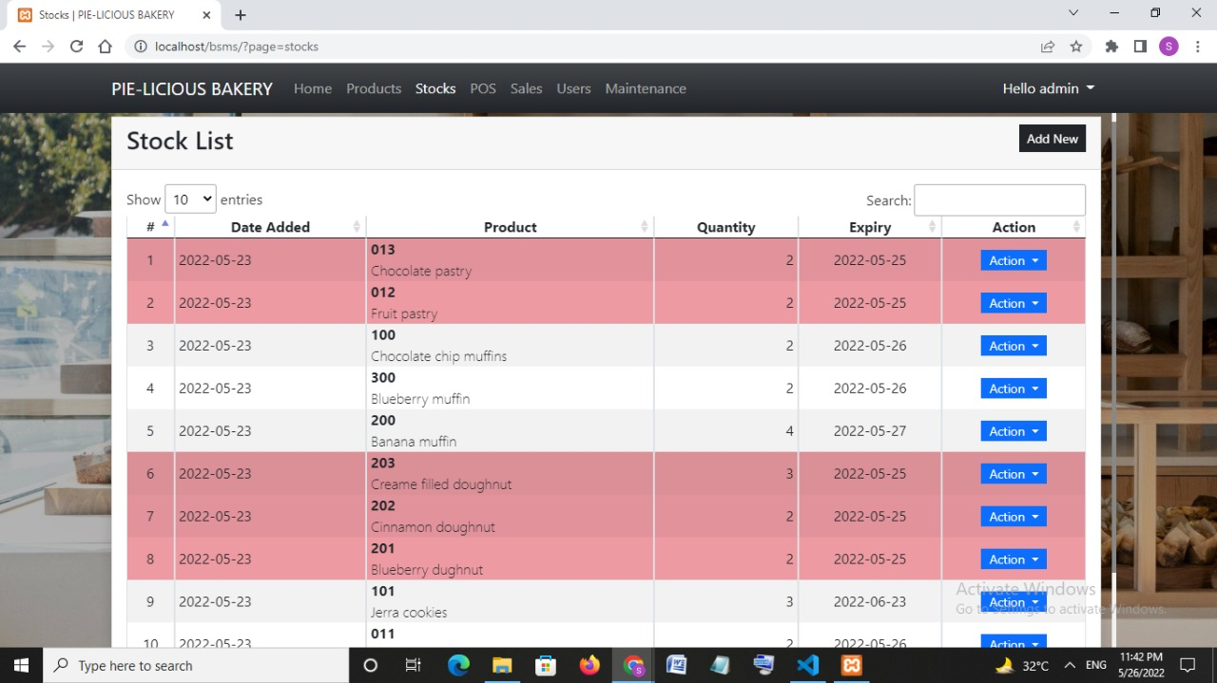
Stock list:

Slide 12
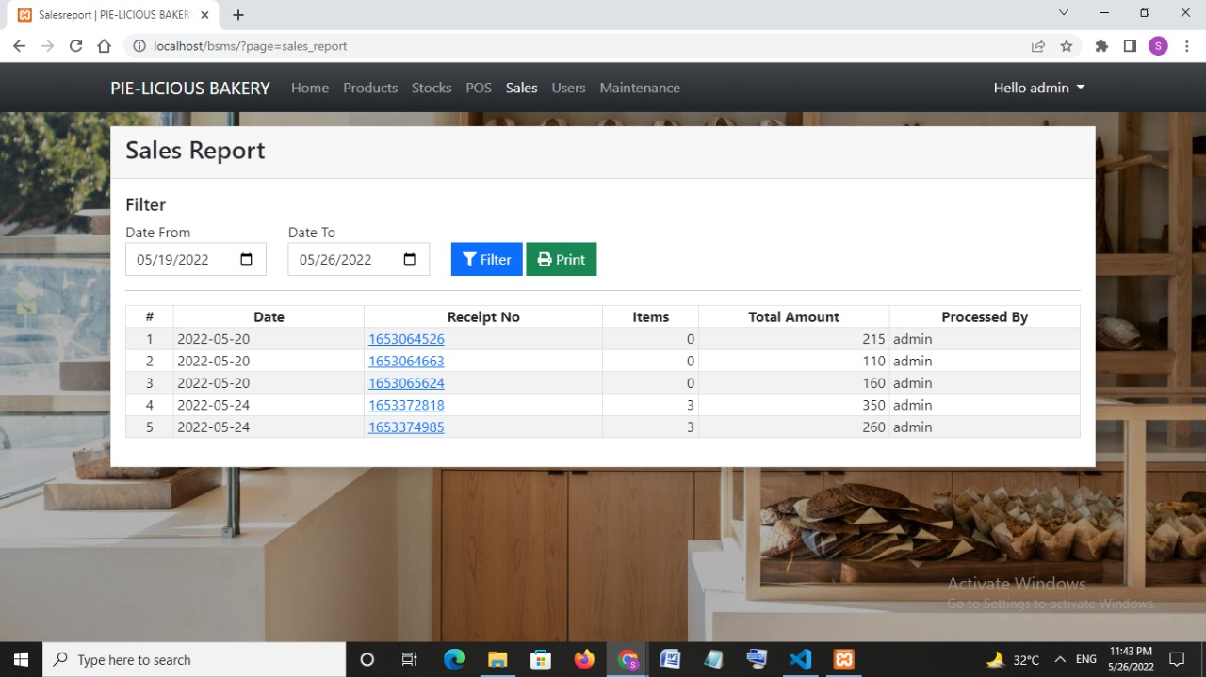
Sales report:

Slide 13
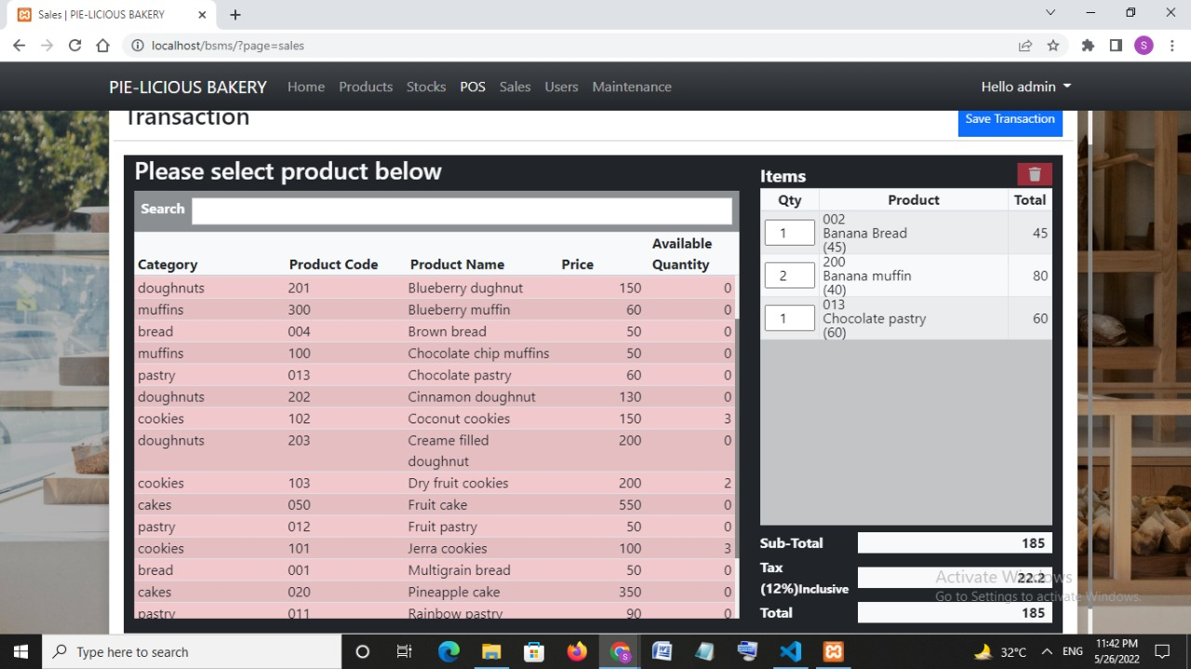
Product of sales:

Slide 14
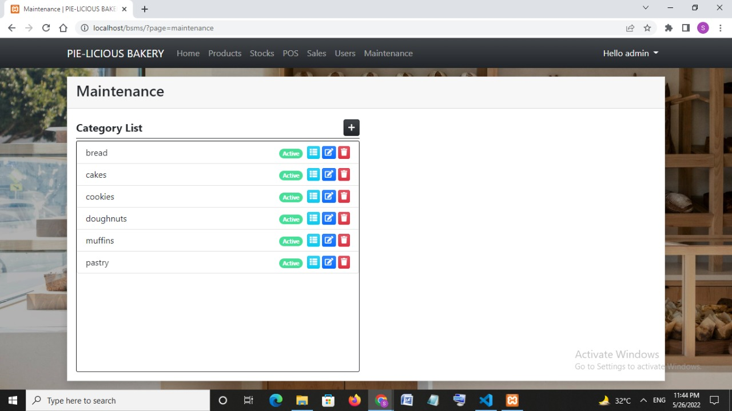
Maintenance:

Slide 15
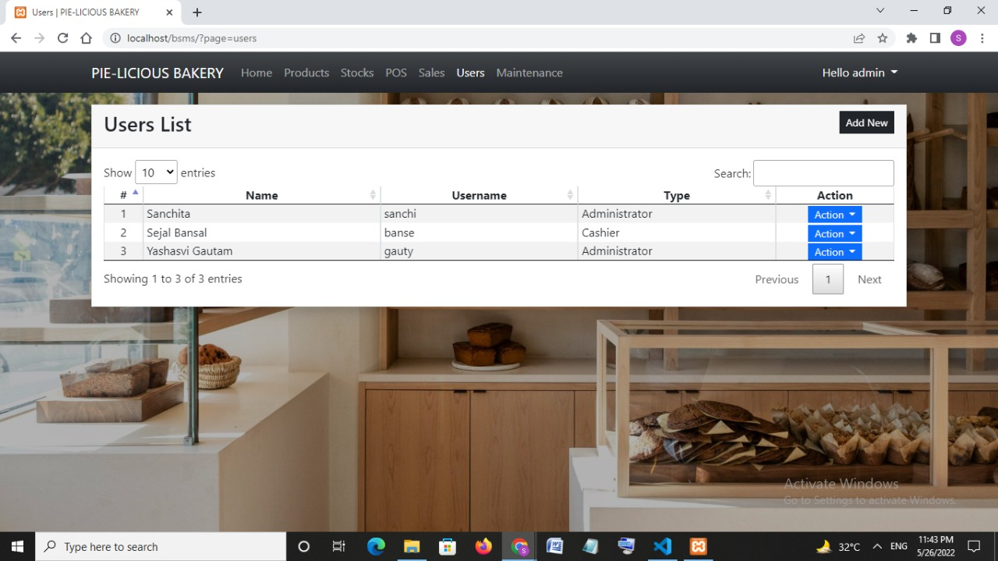
User list:

Slide 16
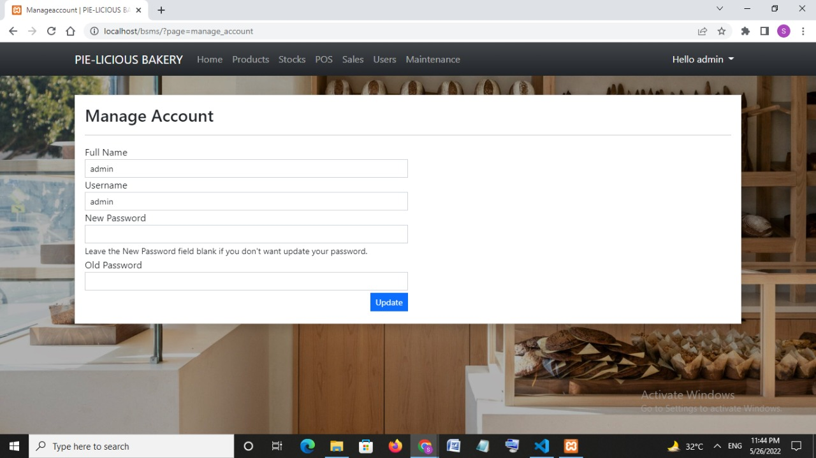
Account:

Slide 17
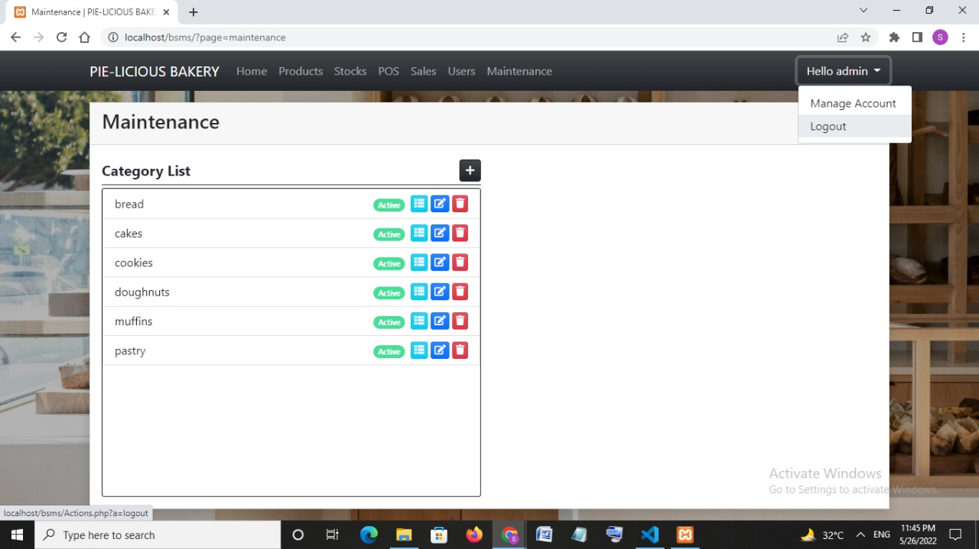
Logout:

Slide 18
THANK YOU!!
Presented by-
Yashasvi Gautam
Sejal Bansal
Sanchita Srivastava

